Slide 1
Outlook for the US Economy in the Coming Year
Steven Kyle Cornell University December 10, 2013

Slide 2
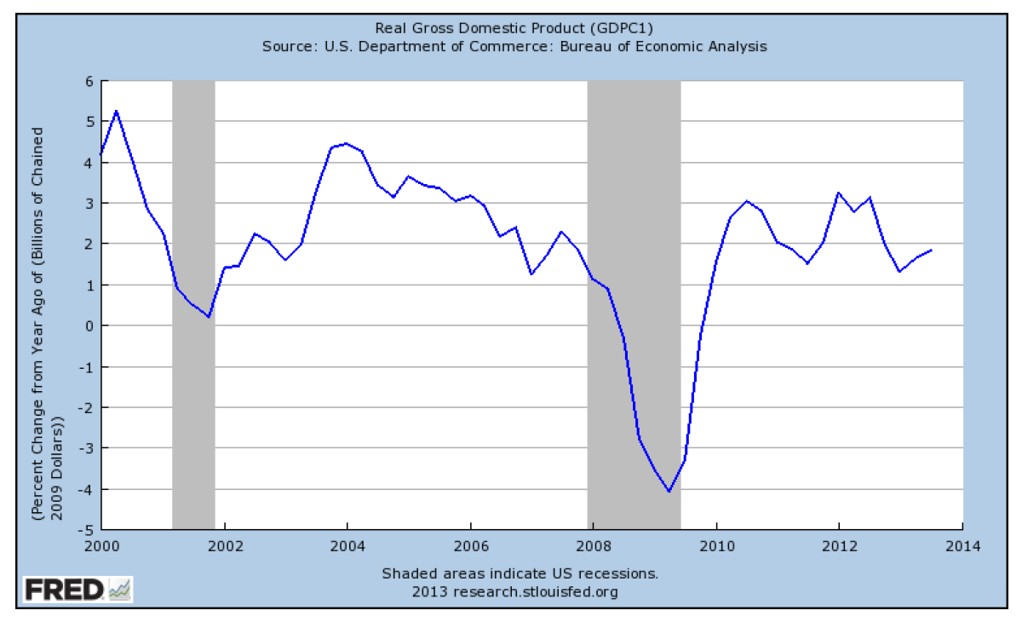
Real GDP Growth Since 2000

Slide 3
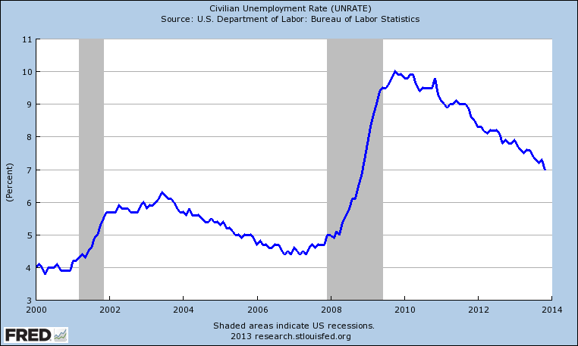
Unemployment Since 2000

Slide 4
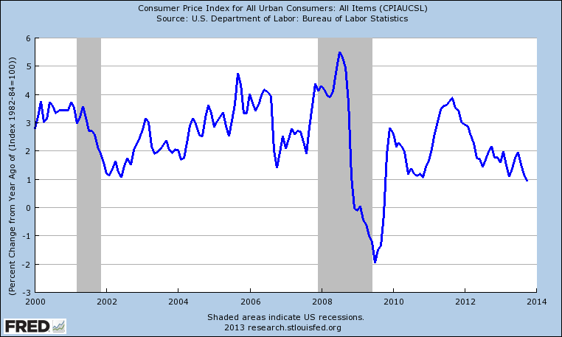
Inflation Since 2000

Slide 5
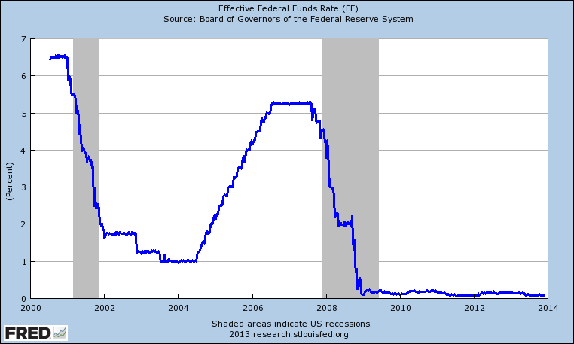
Fed Funds Rate

Slide 6
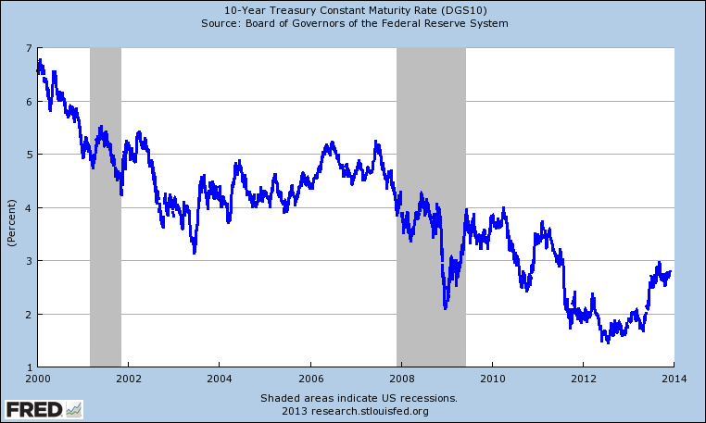
Yield on 10 Year Treasury

Slide 7
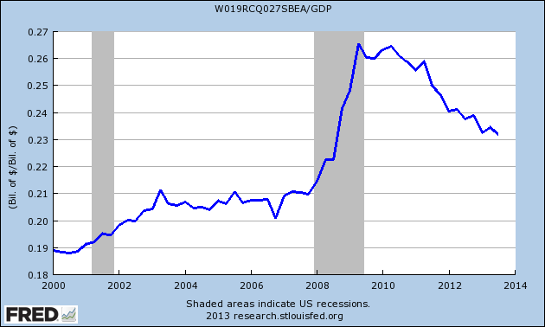
Total Federal Expenditures as a Percent of GDP

Slide 8
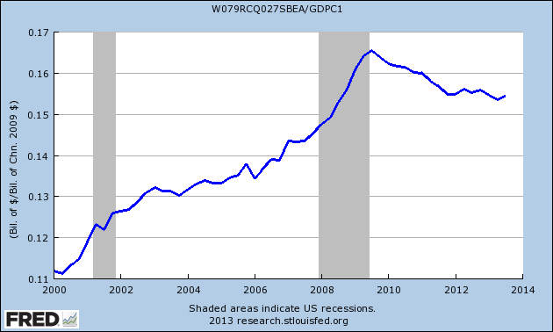
State and Local Spending as a Percent of GDP

Slide 9
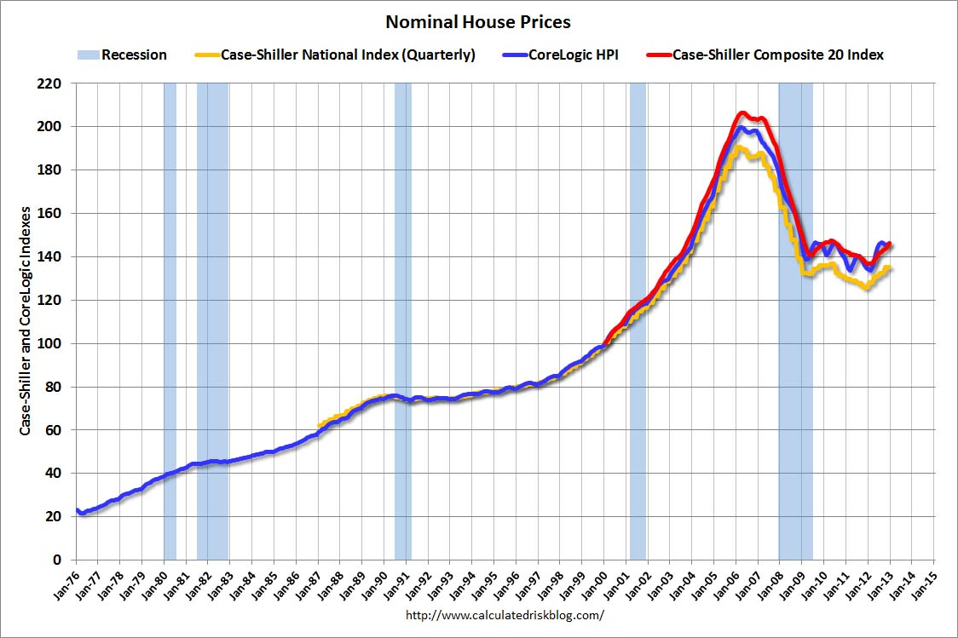

Slide 10
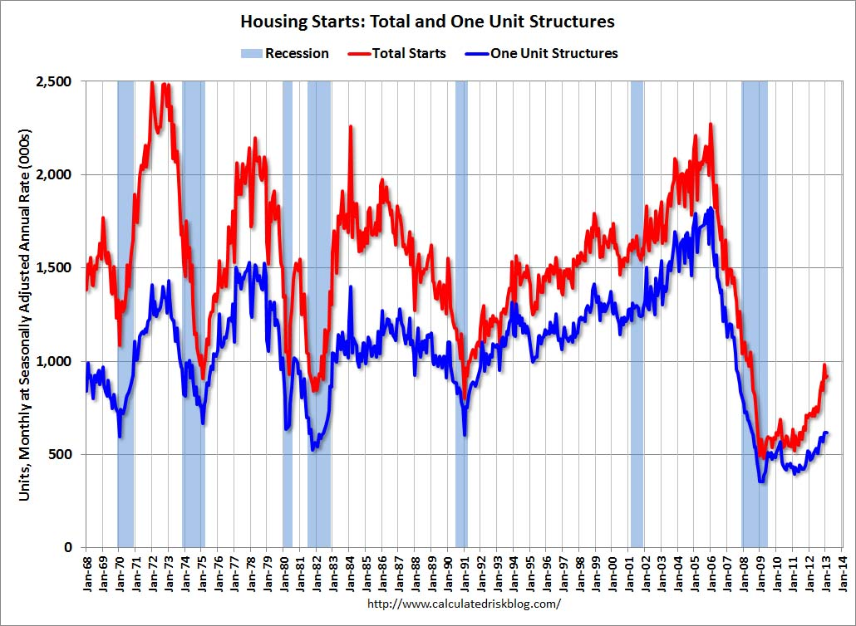

Slide 12
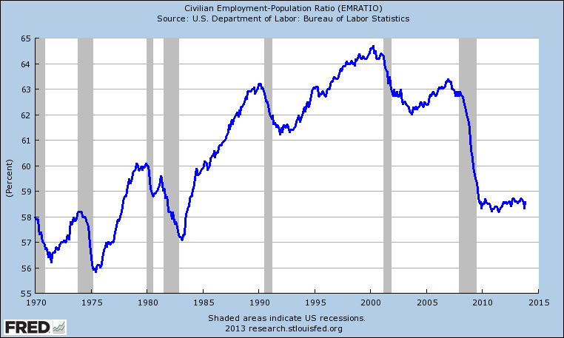
Employment to Population Ratio

Slide 13
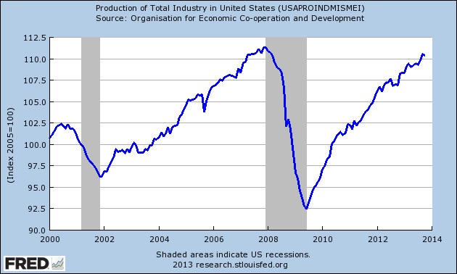
Industrial Production

Slide 14
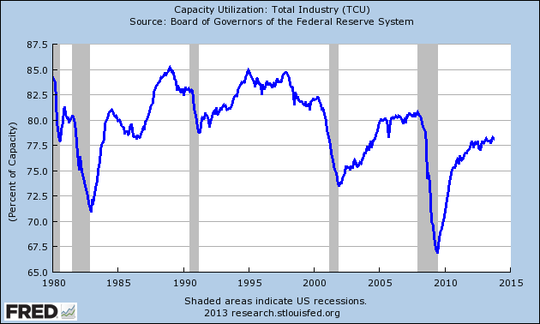
Industrial Capacity Utilization

Slide 15
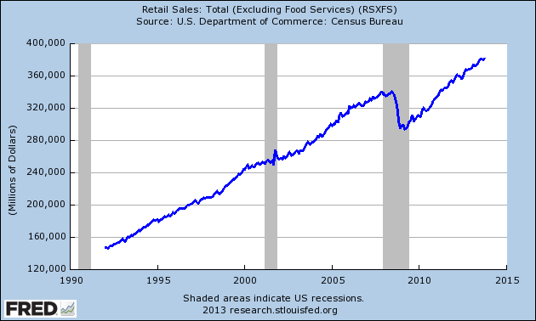
Retail Sales

Slide 16
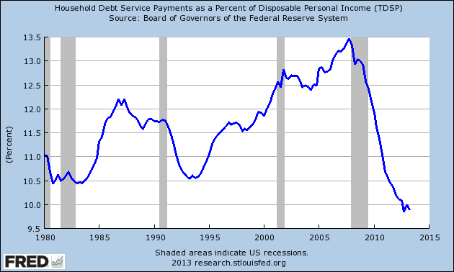
Household Debt Service as Percent of Income

Slide 17
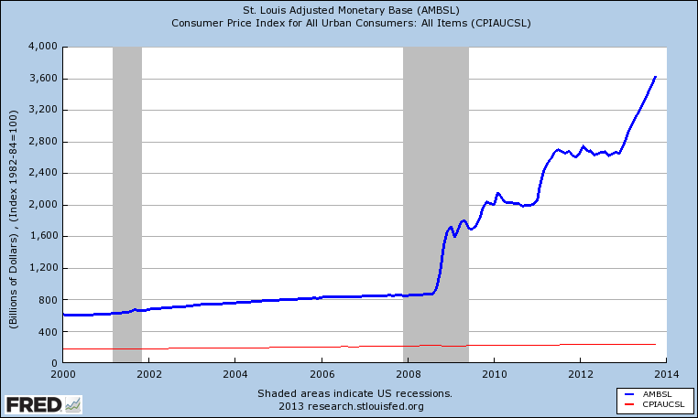
Aggressive Monetary Policy and Low Inflation

Slide 18
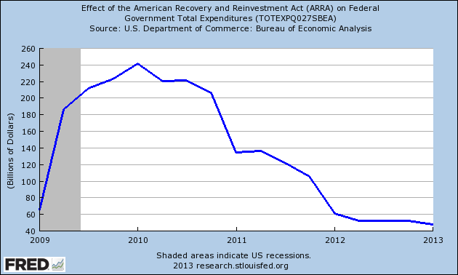
The Stimulus is Just About Gone

Slide 19
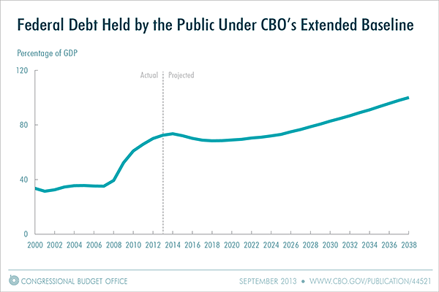

Slide 20
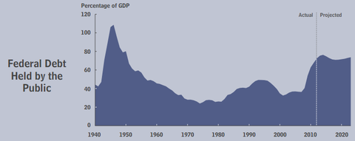
CBO Estimate of Debt/GDP

Slide 21
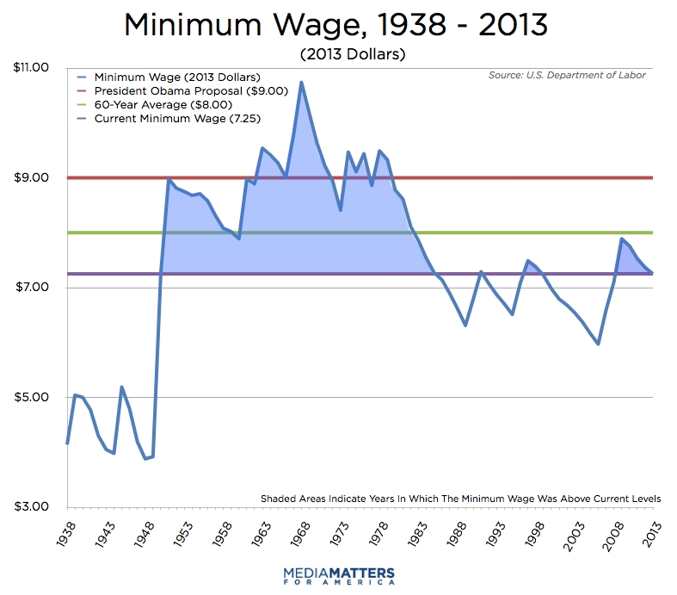

Slide 22
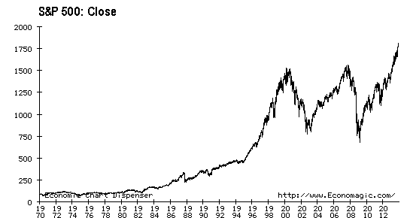
A New Stock Bubble ??

Slide 23
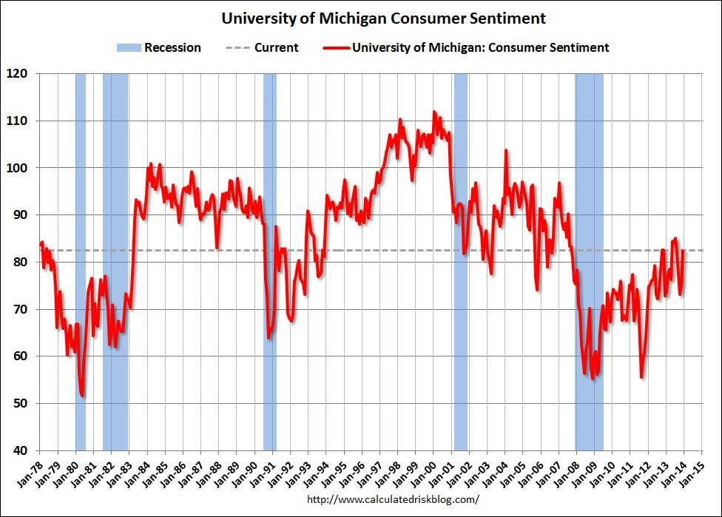

Slide 24
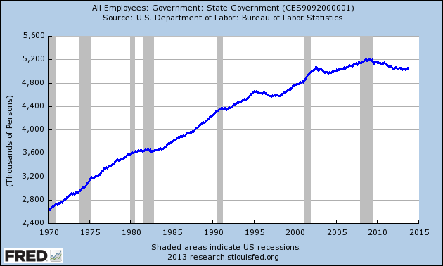
State Government Employment

Slide 25
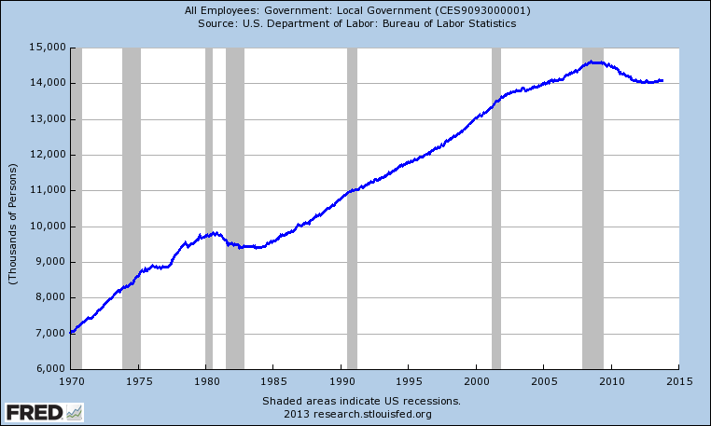
Local Government Employment

Slide 26
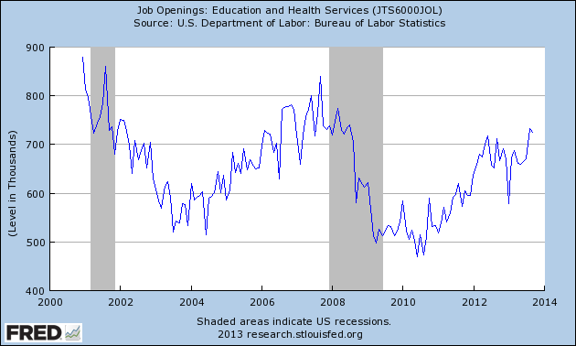
Job Openings in Education & Health – Clearly Rebounding

